Slide 1
Service—news
Input | Output
Tap sequence | Audio
Voice command | Text and picture
Screen input | Video

Slide 2
Input – Basic functions
Functions | Interaction | Scenario 1 In Car | Scenario 2 Home | Scenario 3 Exercising
Wake up | ① Knock twice with the smartwatch | ①② | ①② | ①
 | ② Say “Hi, New”
Play/Pause | ① Say “Play”/”Pause” | ① | ①② | ③
 | ② Press the button on smartwatch screen (specified later)
 | ③ Knock "xx“ on smartwatch
Turn to next news | ① Say “Next” | ① | ①② | ③
 | ② Press the button on smartwatch screen (specified later)
 | ③ Knock “x xx“ on smartwatch

Slide 3
Input – Basic functions
Functions | Interaction | Scenario 1 In Car | Scenario 2 Home | Scenario 3 Exercising
Volume adjustment | ① Say “Up”/“Down”: increase or decrease of the volume is positively proportional with the length of the voice command. | ①②③ | ①③④ | ③④
 | ② Slide up/down with the thumb on the steering wheel, with a sensor or gesture detection camera
 | ③ Drag on smartwatch screen (specified later)
 | ④ Punch up/down with the smartwatch
Choose news genres | ① Choose on the smartphone | ①②③ | ①②③ | ②
 | ② Choose on smartwatch screen
 | ③ Say “Change”

Slide 4
Input – News-related functions
Functions | Interaction | Scenario 1 In Car | Scenario 2 Home | Scenario 3 Exercising
Later viewing | ① Say “Save” | ① | ①② | ②
 | ② Press on the smartphone for 2 seconds
Sharing | ① Share on the smartphone through later-viewing | ①② | ①② | ①
 | ② -User: “Share” -System: “Who do you want to share with?” -User: “XXX“ (with a list of people user often shares news to)
News searching | -User: "Search“ -System: "What do you want to search?“ -User: "KEYWORD" | ● | ●
Related news | Say "Related news" to enter this mode Say "Stop" to exit this mode | ● | ●

Slide 5
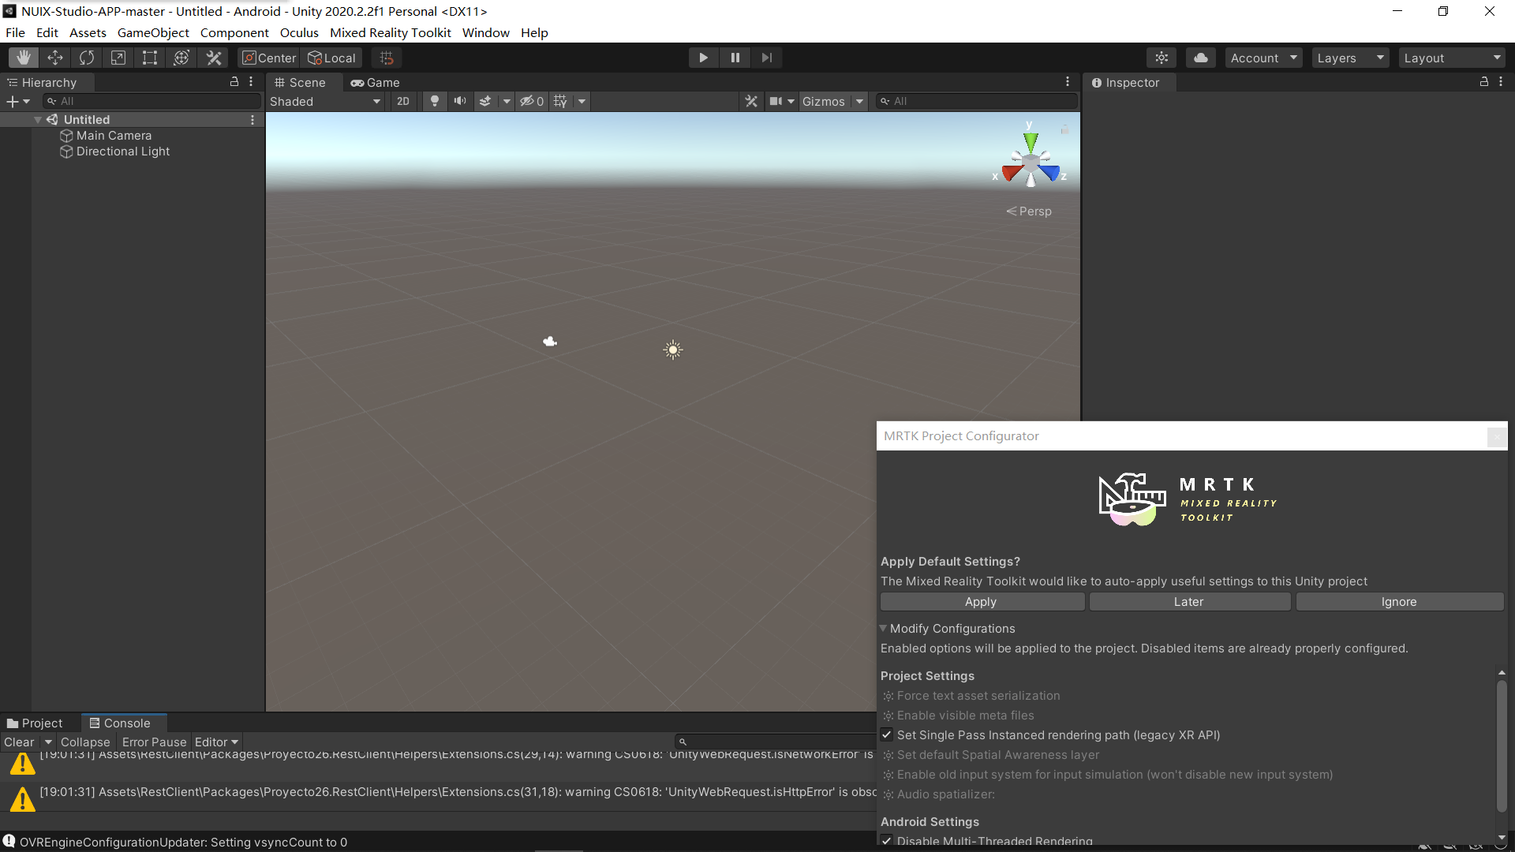
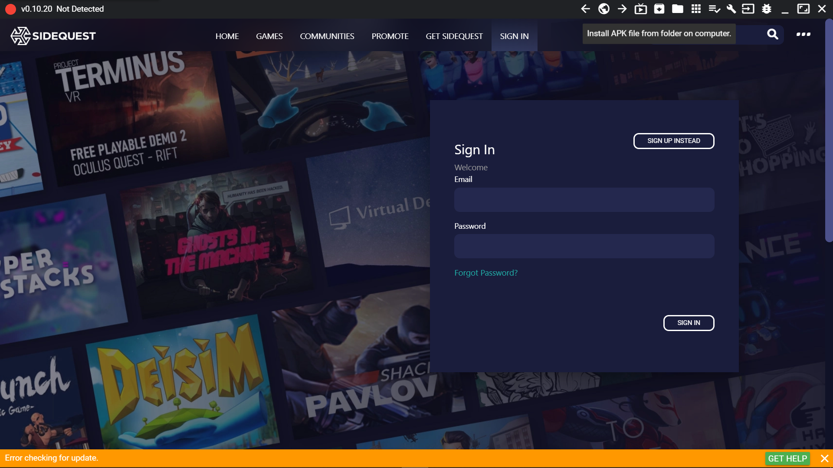
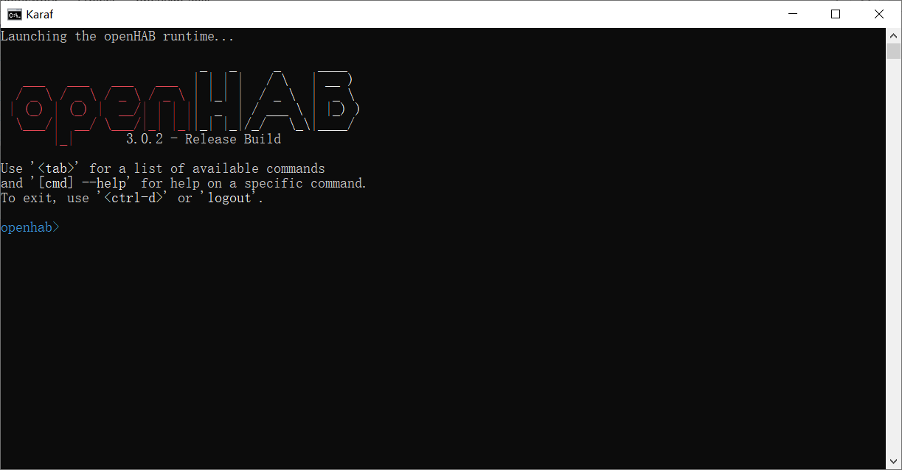
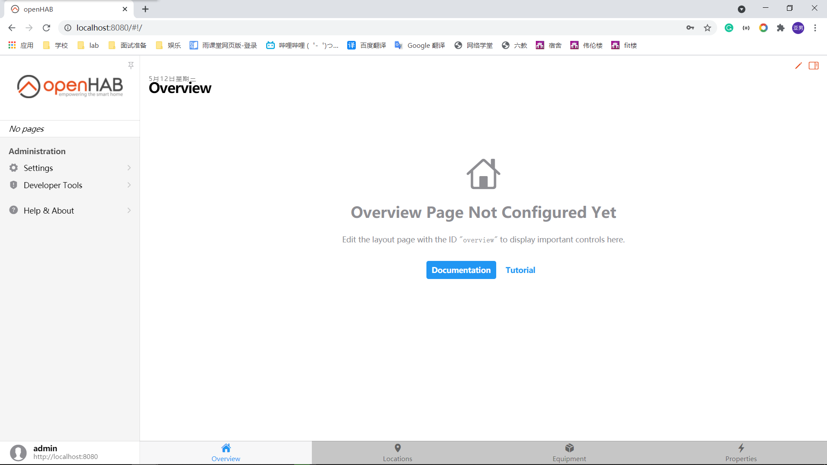
Progress
Unity
Install Unity and Android Build Support
Import NUIX-Studio-APP
Build up the scene
Realize part of the functions
Oculus
Install SideQuest
Install openHAB
Install the apk on Oculus to test

Slide 6

Scenario : Home

Slide 7
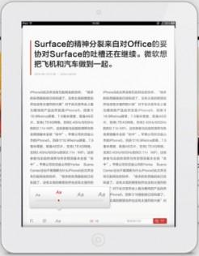
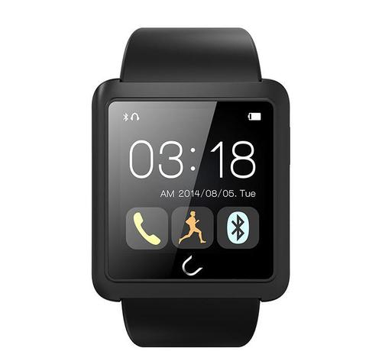
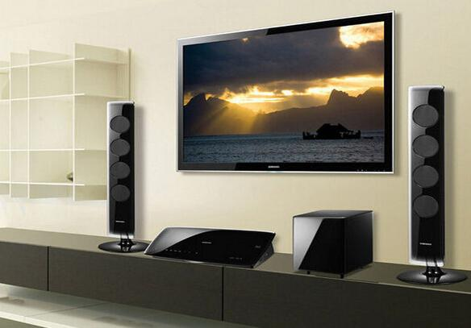
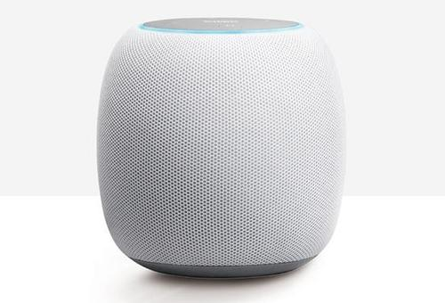
Devices
Smartphone/pad/PC
Smartwatch/bracelet
Smart TV
Bluetooth Speaker/earphones
Hand-pad/Attachable Touchpad
Functions
Basic functions
News-related functions
Transfer of control and content between devices
Separate Input/Output device (Remote control)
Transfer of voice output between stereos according to location
Auto-pause
Auto-correct
Output
News with texts and pictures through smartphone/pad/PC
Video news through smartphone/pad/PC and smart TV
Audio news mainly through Bluetooth Speaker/earphones

Slide 8
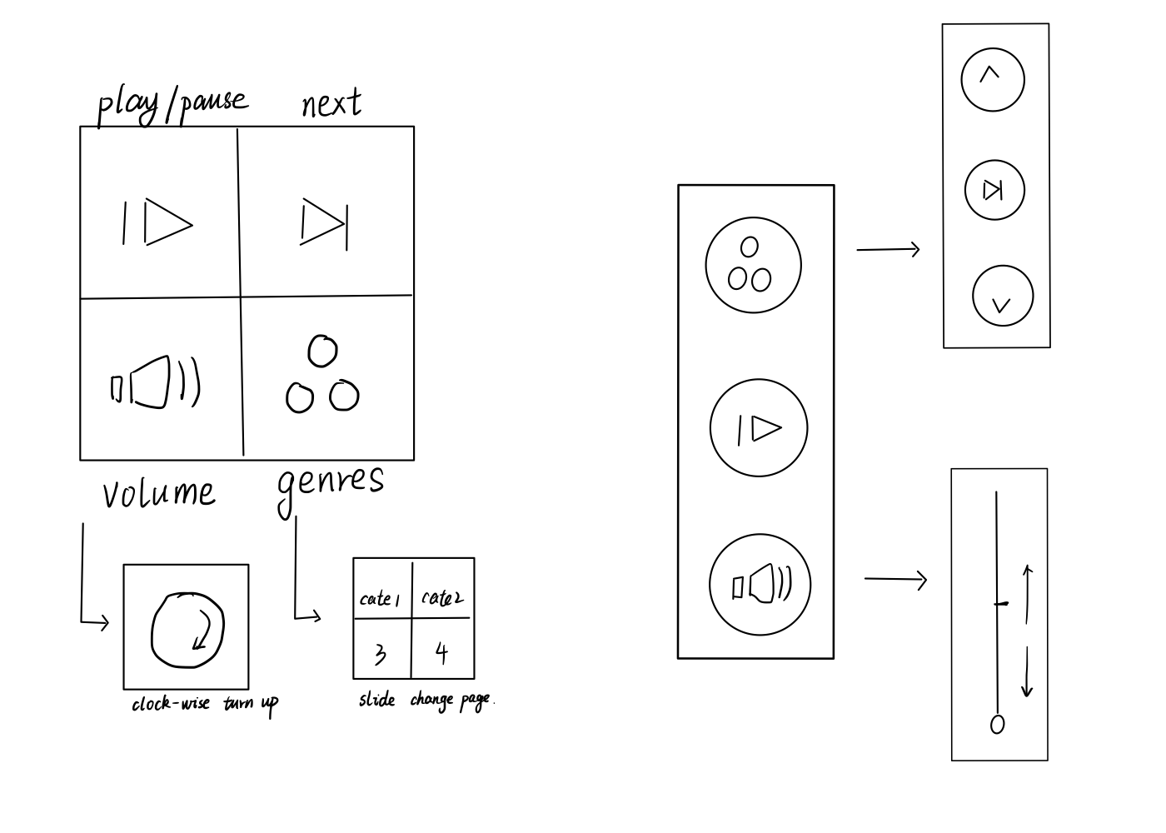
Smartwatch GUI

Slide 9
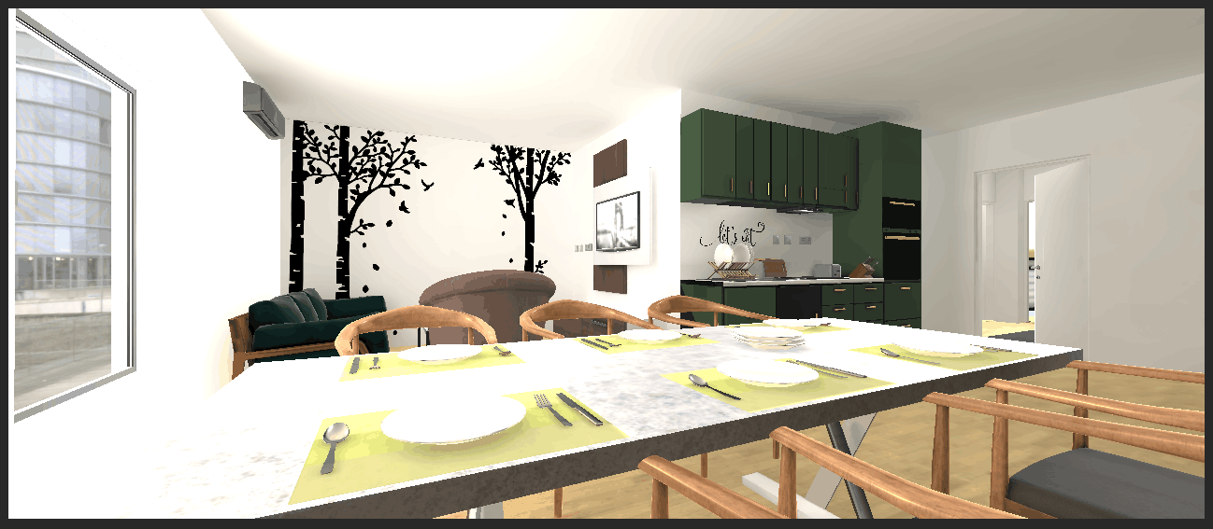
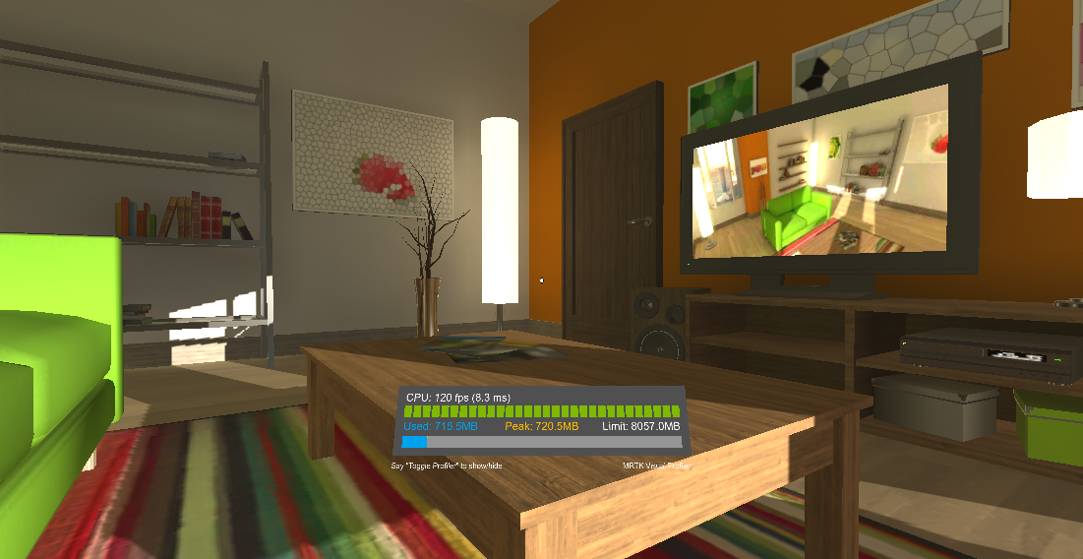
Scene
Take too much time in building

Slide 10
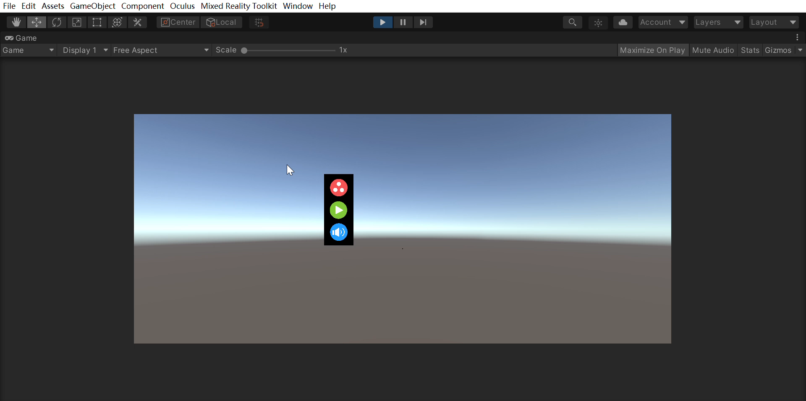
Function

Slide 11
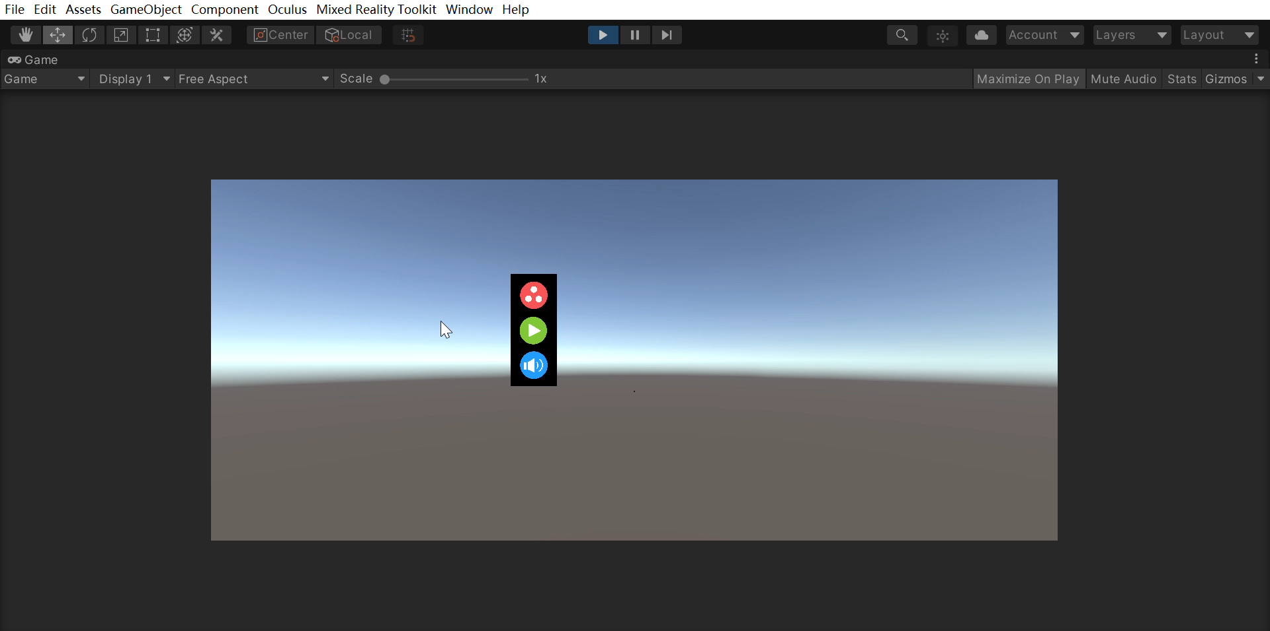
Function

Slide 12
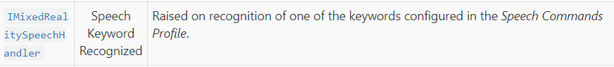
Plan
Voice Control
Location Transfer

Slide 13
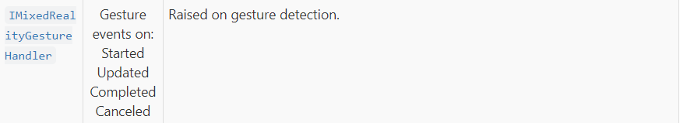
Plan
Gesture Control
Move
Knock

